Slide 1
GAMES 103: Intro to Physics-Based Animation
Instructor: Huamin Wang (games103@style3D.com)
Website: http://games-cn.org/games103
Meeting: Monday 4:00PM to 5:30PM
Length: 12 Weeks
Q&A: Monday 5:30PM to 6:00PM
Grader: …
Prerequisites: Linear algebra, calculus, programming skills

Slide 2

Course exchange Wechat group
(Join by scanning Wechat QR Code )

Slide 3
More About Prerequisites
The course is designed for
Undergraduates in the 3rd or 4th year, or fresh graduates.
Linear Algebra
You Should know basic linear algebra concepts, such as vectors, matrices, linear systems, SVD...
Calculus
You should know how to calculate basic derivatives and integrals; you should understand chain rules, gradients, etc.
Programming Skills
C, or C++, or C#, or Javascript
Ready to learn by yourself
The life will be much easier if you took
Numerical methods (numerical linear algebra, numerical PDEs), finite element analysis, fluid dynamics...

Slide 4
Tentative Syllabus
Days |  | Topics | Assignments
Day 1 | 11/1/2021 | Introduction
Day 2 | 11/8/2021 | Math Background
Day 3 | 11/15/2021 | Rigid Body Dynamics
Day 4 | 11/22/2021 | Rigid Body Contacts | HW 1
Day 5 | 11/29/2021 | Mass-Spring Systems
Day 6 | 12/6/2021 | Position-Based Dynamics, Projective Dynamics and more | HW 2
Day 7 | 12/13/2021 | Collision Handling of Cloth
Day 8 | 12/20/2021 | Soft Body Dynamics and Finite Element Method I | HW 3
Day 9 | 12/27/2021 | Soft Body Dynamics and Finite Element Method II
Day 10 | 1/3/2021 | Waves | HW 4
Day 11 | 1/10/2021 | Incompressible Fluid Dynamics and Eulerian Fluids
Day 12 | 1/17/2021 | SPH and Position-Based Fluids
No Exam!

Slide 5

No textbook, but a lot of suggested readings.
Readings help you pick up insights missing from class.

Slide 6


Slide 7


Slide 8

The goal is to use Unity for learning, NOT to learn Unity.

Slide 9
What you need to succeed...
Get prepared (prerequisites, Unity, etc.)
Attend meetings, or watch the replay
Finish supplemental readings
Do HWs
No need fancy graphics card. Your laptop should suffice.
Read more, write more, think more...

Slide 10
Issues for Discussion Today
What’s computer graphics?
What’s computer graphics used for?
What’s physics-based animation?
What are the topics to be studied in this class?

Slide 11
Issues for Discussion Today
What’s computer graphics?
What’s computer graphics used for?
What’s physics-based animation?
What are the topics to be studied in this class?

Slide 12
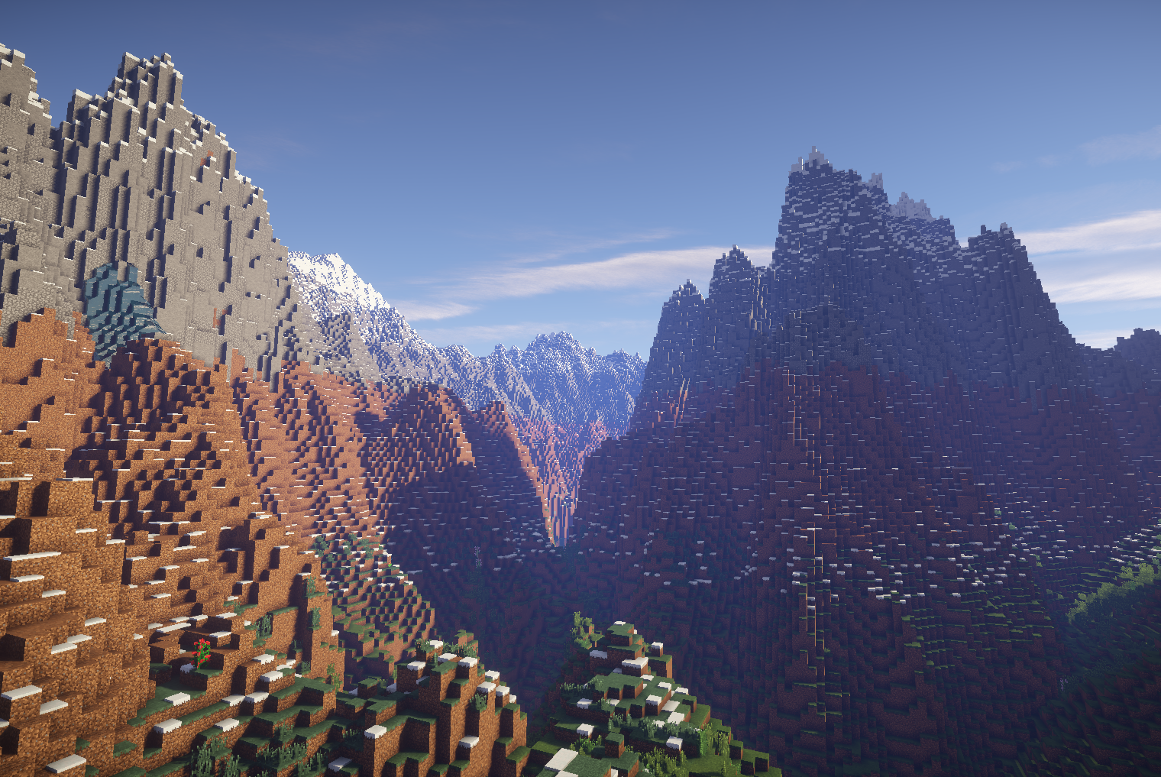

What’s Computer Graphics?
Computer Graphics
Computer Vision
3D Digital World
2D Digital Images

Slide 13
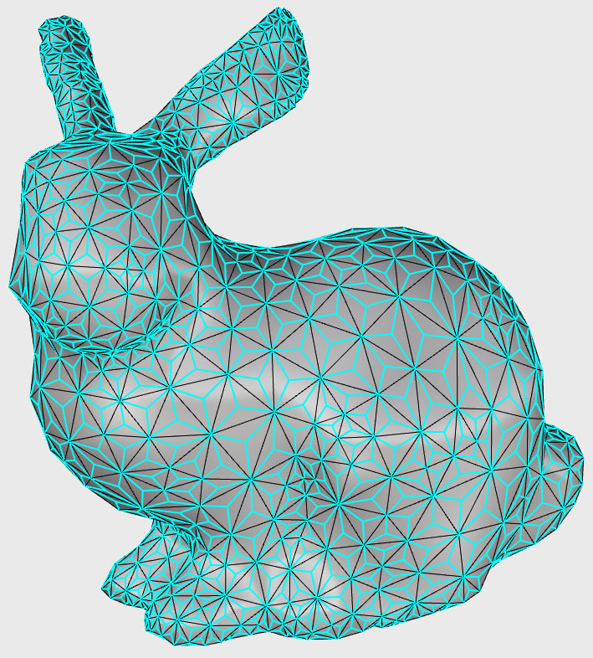
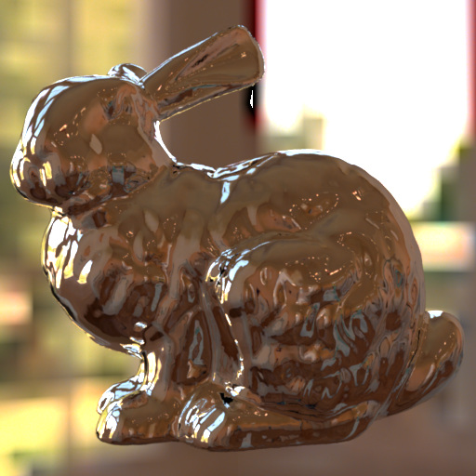

Computer Graphics Areas
Geometry: Modeling the 3D world
Rendering: Visualize the 3D world
Animation: Animate the 3D world
Stanford Bunny: the de facto standard model for graphics research, created by Greg Turk in 1994 at Stanford.
http://graphics.stanford.edu/data/3Dscanrep/

Slide 14

Real-Time Graphics Pipeline
Geometry
Animation
Rendering
Display
Offline

Slide 15
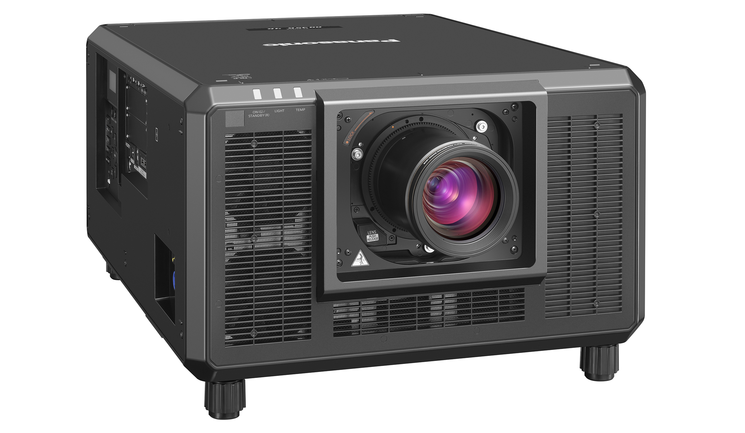
The number of frames sent to display in a second is called the frame rate. For example, 24 FPS, 30 FPS, 60 FPS, …

Slide 16

Unfortunately, real-time graphics (real-time animation + real-time rendering) is challenging. Without real-time graphics, graphics applications are narrowly limited…

Slide 17
Animation Playback
Geometry
Animation
Rendering
Display
Offline
Offline

Slide 18
Movie
Geometry
Animation
Rendering
Display
Offline
Offline
Offline

Slide 19
Geometry: Three Representations
A mesh contains:
Vertices (nodes)
Elements (triangles, polygons, tetrahedra…)
Triangle mesh is the foundation of graphics.
Problems:
Meshing (Delaunay triangulation)
Simplification/subdivision
Mesh optimization (smoothing, flows…)
Volume mesh
Mesh

Slide 20
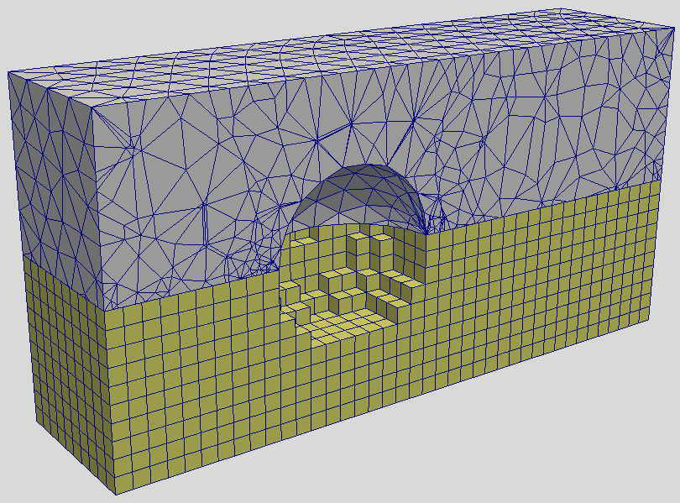
Geometry: Three Representations
Structured Mesh
Unstructured Mesh

Slide 21
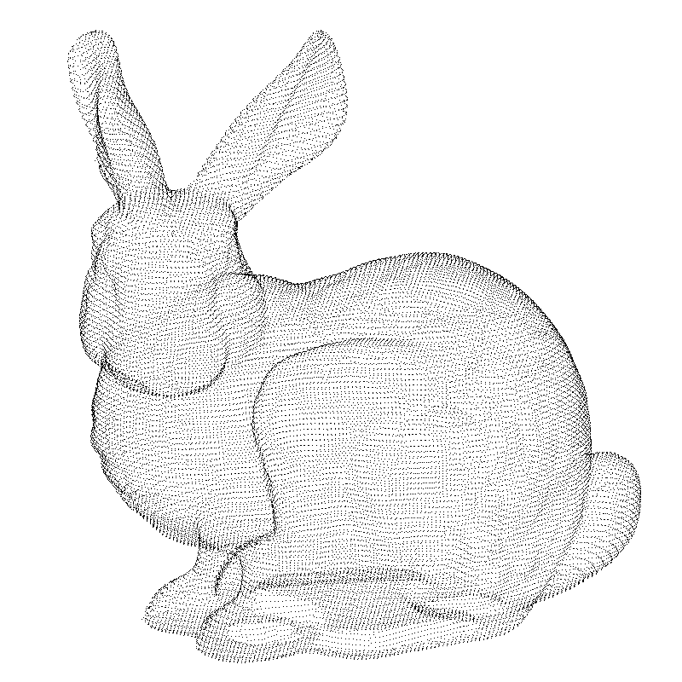
Geometry: Three Representations
A point cloud is simple.
It can be raw data from surface scan.
Problems:
Mesh reconstruction from cloud
(Re)-Sampling
Neighborhood search
…
Point Cloud

Slide 22
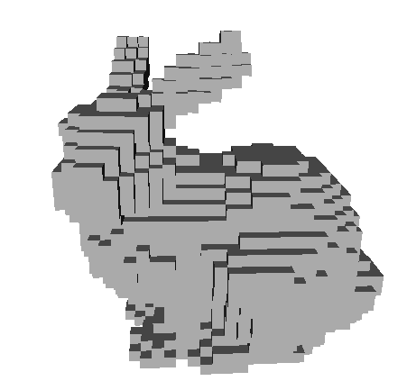
Geometry: Three Representations
A grid partitions the space; a cell stores the physical quantities at that spot.
Don’t confuse it with structured mesh.
It’s often acquired from volumetric scan, e.g., CT.
Problems:
Memory cost (octree?)
Volumetric rendering?
…
Volumetric Grid

Slide 23
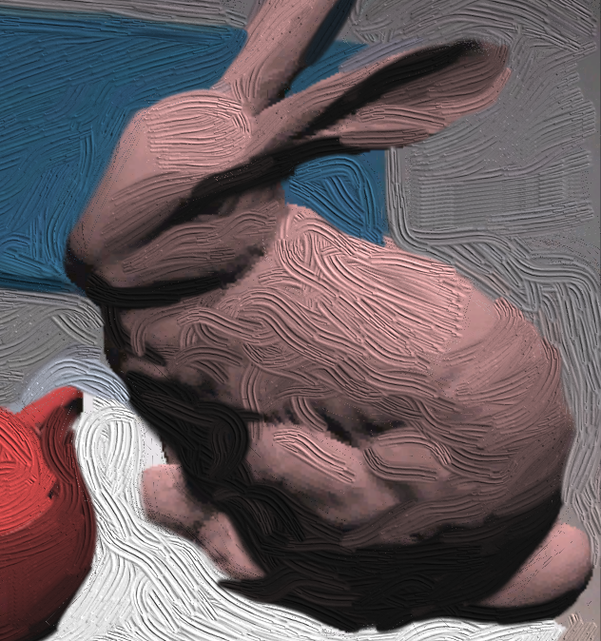
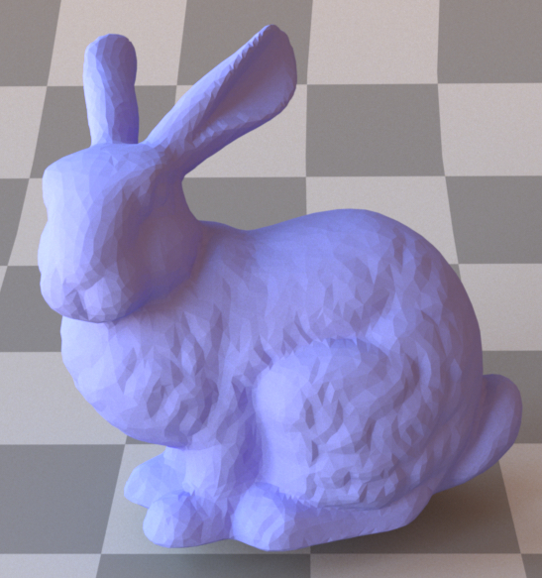
Rendering: Non-Photorealistic vs. Photorealistic
Non-Photorealistic
Photorealistic

Slide 24
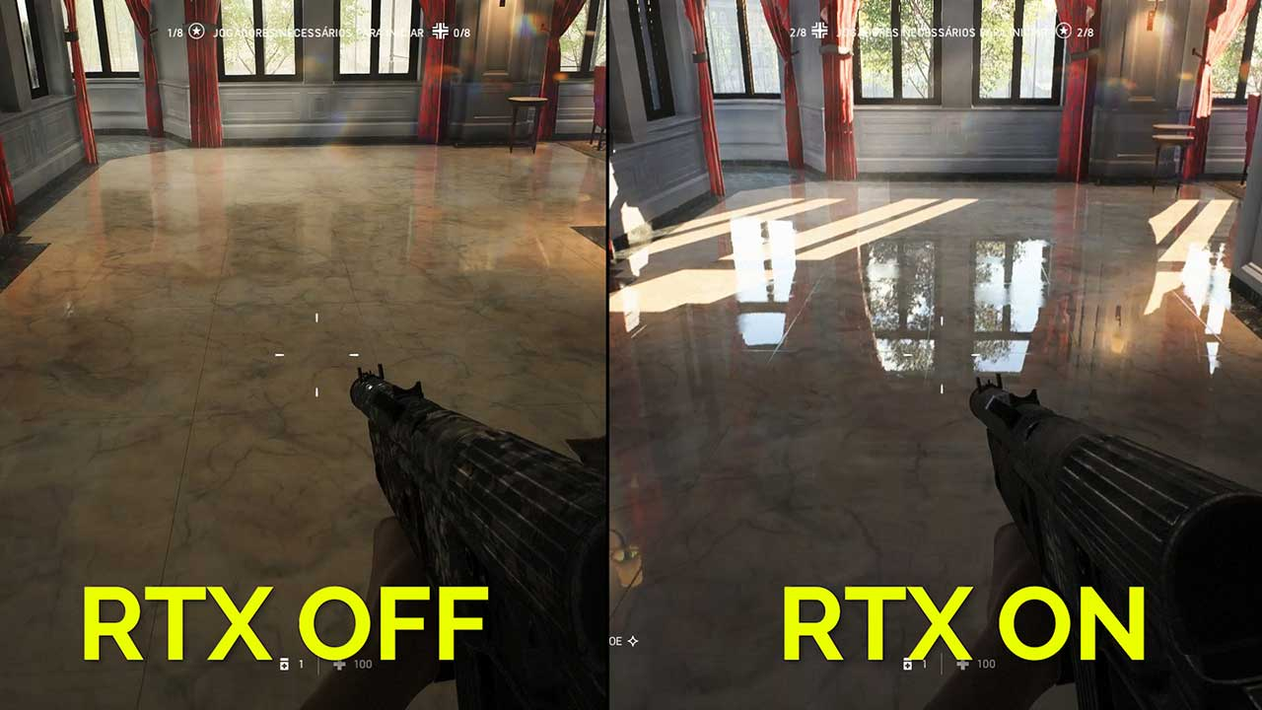

Slide 25
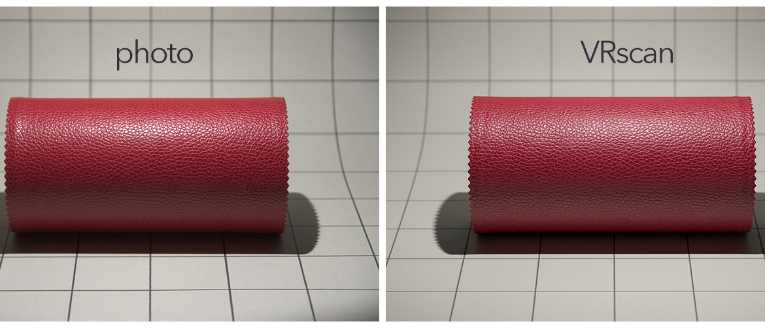
Rendering: Material Scan

Slide 26
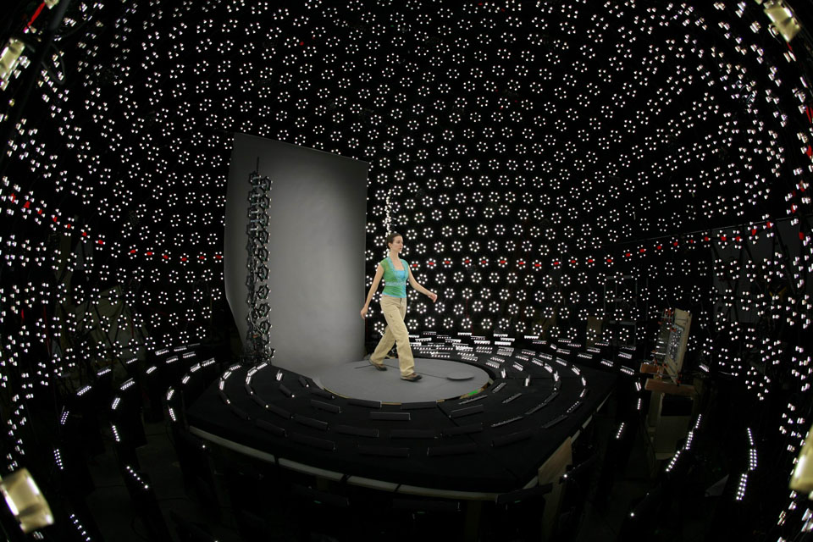
Rendering: Body Scan by a Light Stage

Slide 27
Issues for Discussion Today
What’s computer graphics?
What’s computer graphics used for?
What’s physics-based animation?
What are the topics to be studied in this class?

Slide 28
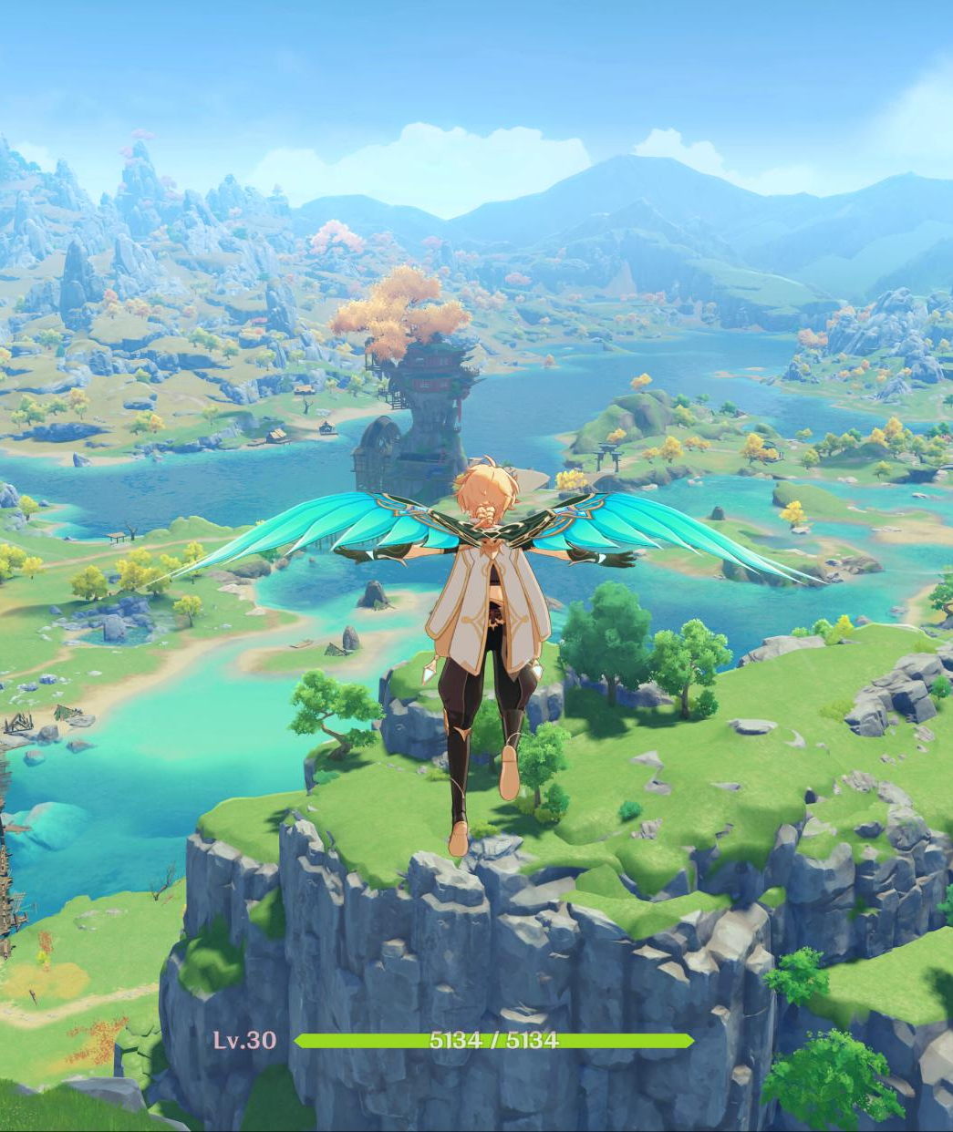


Computer Graphics for Entertainment
Games
Special Effects
Social Media

Slide 29
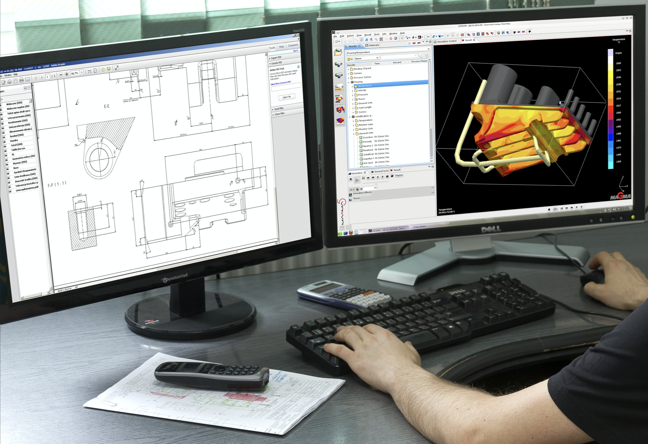
Computer Graphics for Design
Mechanics
Architecture
Art
Fashion
and more…

Slide 30
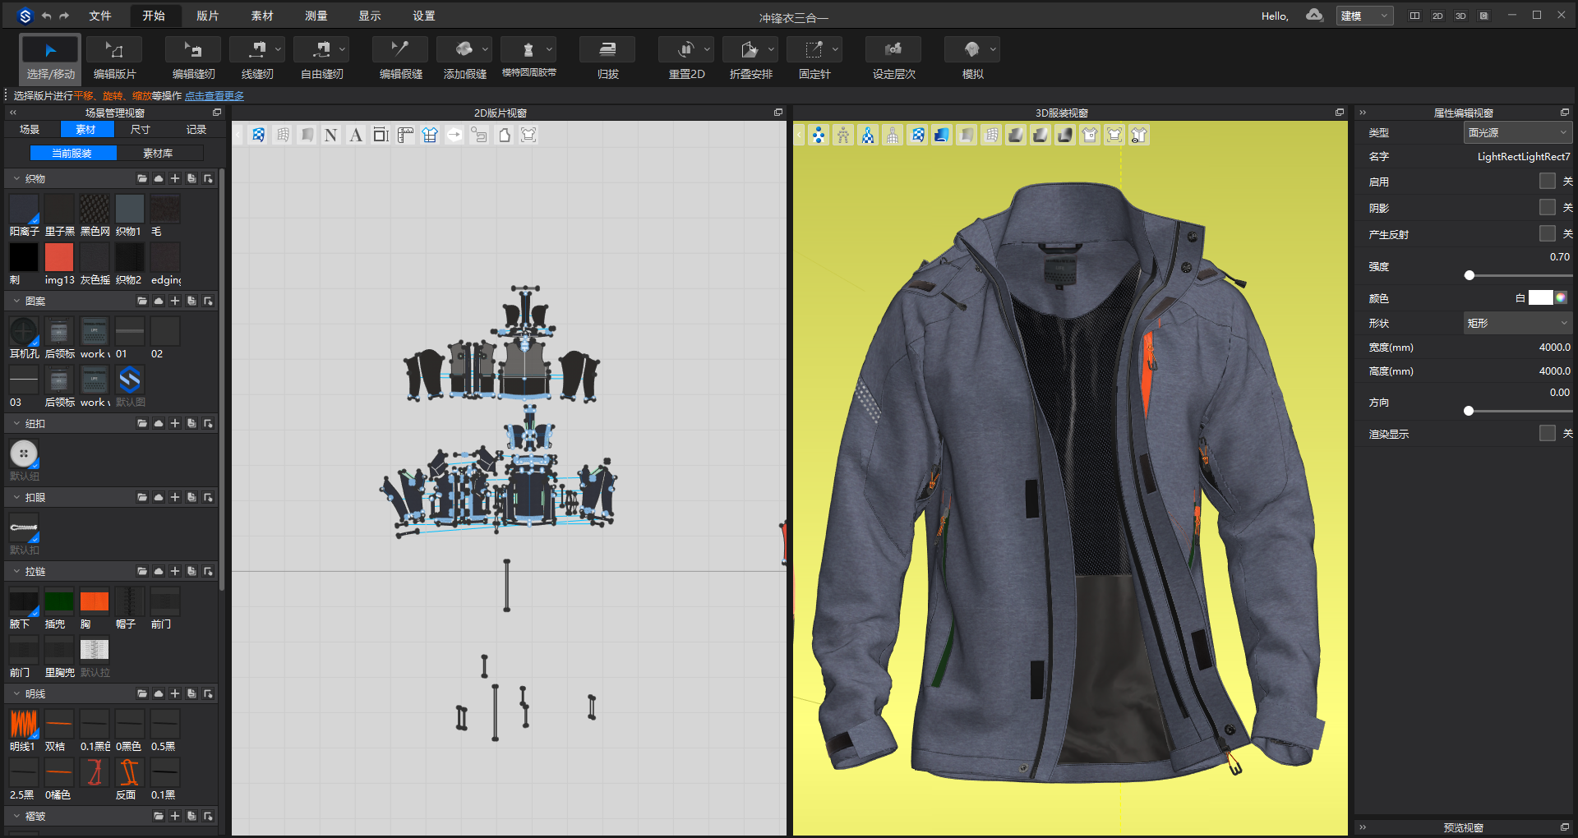
Designed by Style3D

Slide 31


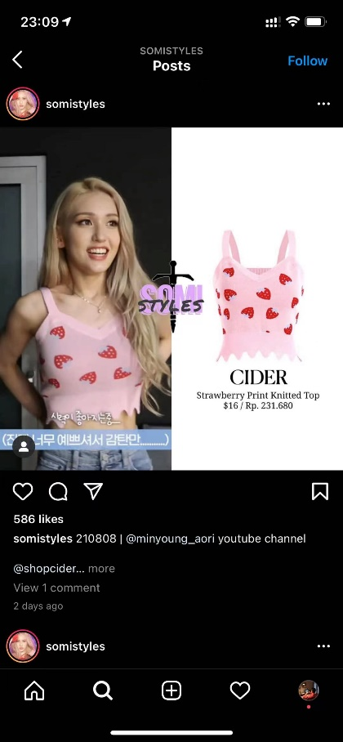
Computer Graphics for Retail and Manufacturing

Slide 32

Computer Graphics for VR, AR and Metaverse

Slide 33




Computer Graphics for Augmented Reality (AR)
Virtual Clothing
Photo
Virtual Clothing
Photo

Slide 34
Issues for Discussion Today
What’s computer graphics?
What’s computer graphics used for?
What’s physics-based animation?
What are the topics to be studied in this class?

Slide 35
Animation Paradigm
The goal of animation is to update the state in every time step.
The state can be:
Position/orientation
Velocity
Appearance
Density
…
The time step doesn’t have to match the frame rate.
It’s common to animate multiple time steps then render one frame.
Time t₀
State_0
Time Step
Δt
Time t₁
State_1
Animation
Time t_{n}
State_n

Slide 36

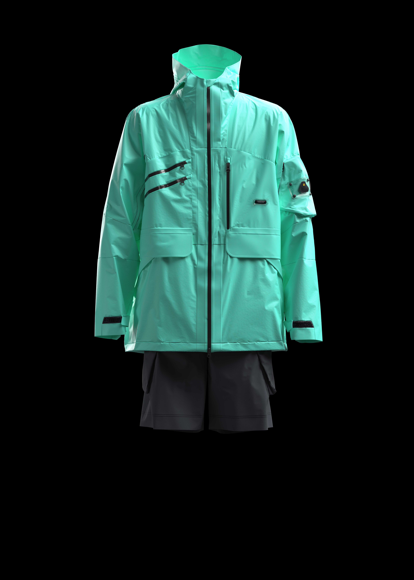
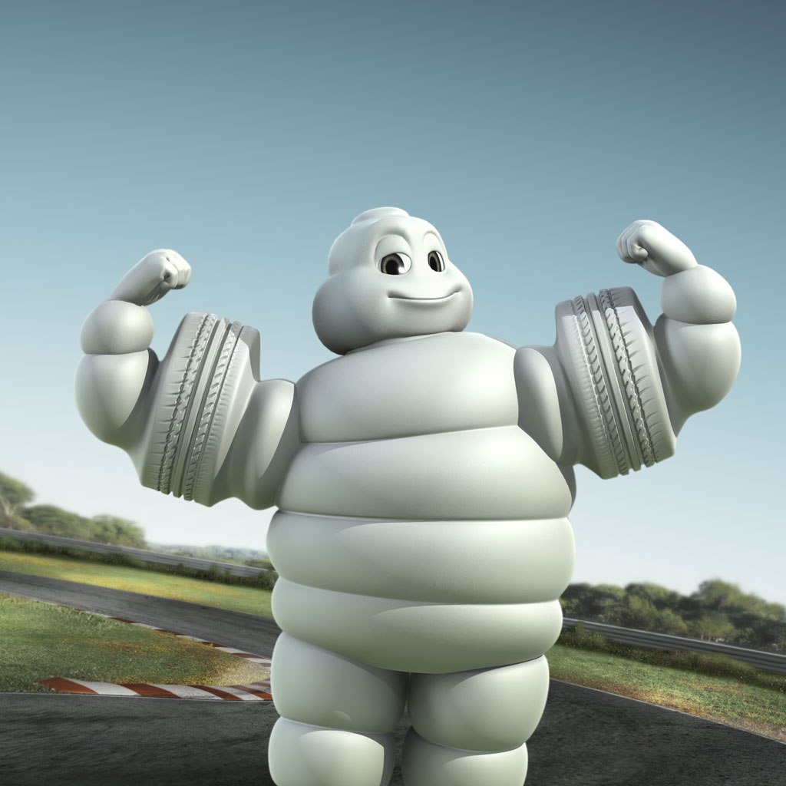
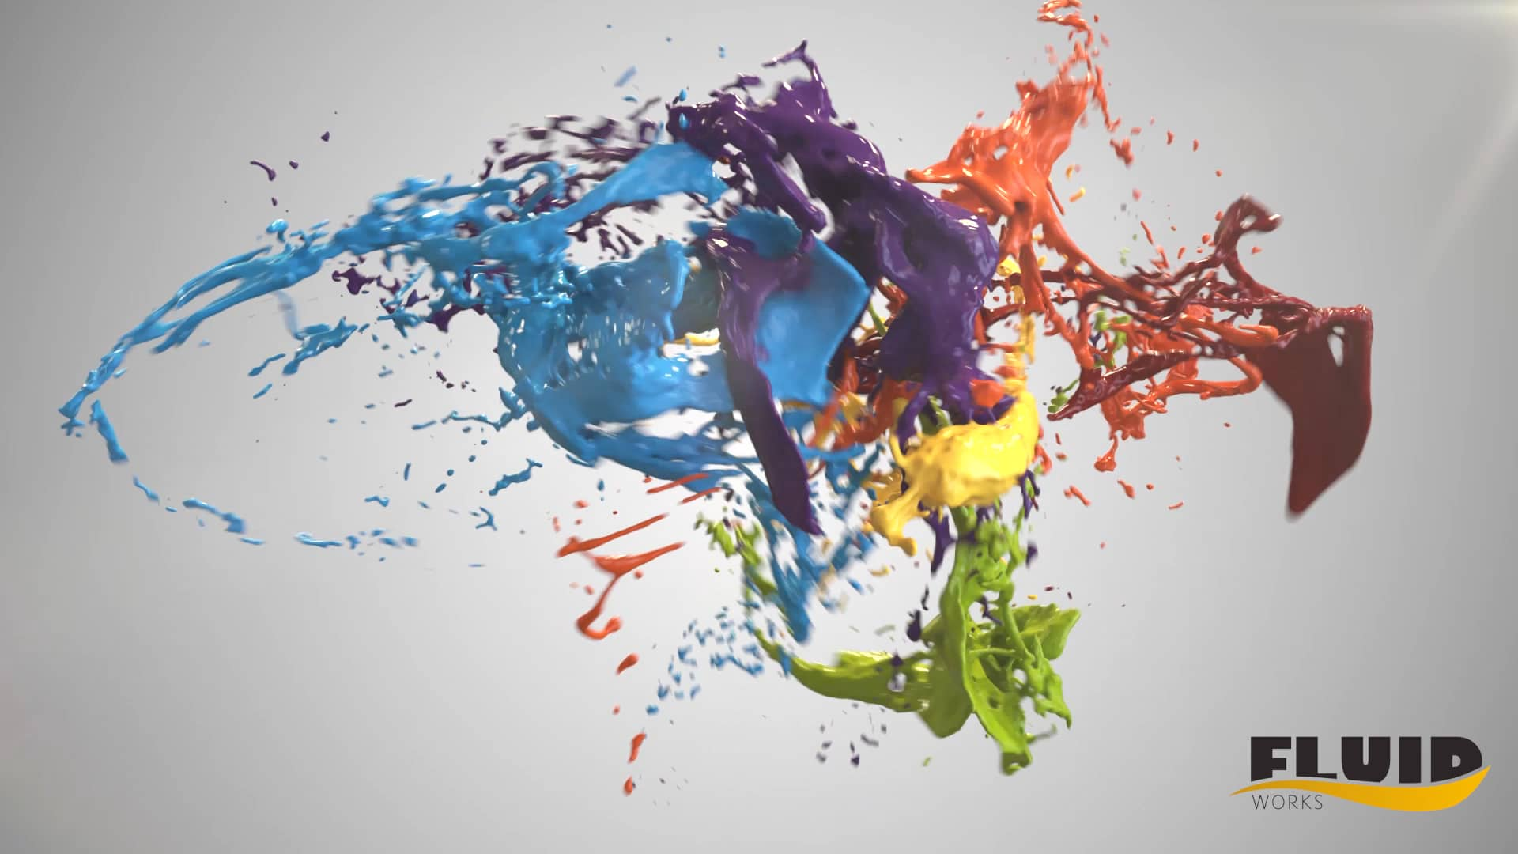
Physics-Based Animation Topics
Rigid Bodies
Cloth and Hair
Soft Bodies
Fluids

Slide 37
Physics-Based Animation Topics
Contents | Rigid Bodies |  | Cloth and Hair |  | Soft Bodies |  | Fluids
Effects | Contacts | Fracture | Cloth | Hair | Elastic | plastic | Smoke | Drops and Waves | Splashes
Mesh | ✓ | ✓ | ✓ | ✓ | ✓ | ✓
Particle
Grid

Slide 38
Physics-Based Animation Topics
Contents | Rigid Bodies |  | Cloth and Hair |  | Soft Bodies |  | Fluids
Effects | Contacts | Fracture | Cloth | Hair | Elastic | plastic | Smoke | Drops and Waves | Splashes
Mesh | ✓ | ✓ | ✓ | ✓ | ✓ | ✓
Particle |  | ☆ (meshless)
Grid |  |  | ☆ (contact) | ☆ (contact)
To avoid remeshing
To simplify contacts

Slide 39
Physics-Based Animation Topics
Contents | Rigid Bodies |  | Cloth and Hair |  | Soft Bodies |  | Fluids
Effects | Contacts | Fracture | Cloth | Hair | Elastic | plastic | Smoke | Drops and Waves | Splashes
Mesh | ✓ | ✓ | ✓ | ✓ | ✓ | ✓
Particle |  | ☆ (meshless) |  |  |  |  | ✓ (real-time)
Grid |  |  | ☆ (contact) | ☆ (contact) |  |  | ✓

Slide 40
Physics-Based Animation Topics
Contents | Rigid Bodies |  | Cloth and Hair |  | Soft Bodies |  | Fluids
Effects | Contacts | Fracture | Cloth | Hair | Elastic | plastic | Smoke | Drops and Waves | Splashes
Mesh | ✓ | ✓ | ✓ | ✓ | ✓ | ✓ |  | ✓ (real-time)
Particle |  | ☆ (meshless) |  |  |  |  | ✓ (real-time)
Grid |  |  | ☆ (contact) | ☆ (contact) |  |  | ✓ | ✓

Slide 41
Physics-Based Animation Topics
Contents | Rigid Bodies |  | Cloth and Hair |  | Soft Bodies |  | Fluids
Effects | Contacts | Fracture | Cloth | Hair | Elastic | plastic | Smoke | Drops and Waves | Splashes
Mesh | ✓ | ✓ | ✓ | ✓ | ✓ | ✓ |  | ✓ (real-time) | ?
Particle |  | ☆ (meshless) |  |  |  |  | ✓ (real-time) |  | ✓
Grid |  |  | ☆ (contact) | ☆ (contact) |  |  | ✓ | ✓ | ✓

Slide 42
Physics-Based Animation Topics
Coupling
Contents | Rigid Bodies |  | Cloth and Hair |  | Soft Bodies |  | Fluids
Effects | Contacts | Fracture | Cloth | Hair | Elastic | plastic | Smoke | Drops and Waves | Splashes
Mesh | ✓ | ✓ | ✓ | ✓ | ✓ | ✓ |  | ✓ (real-time) | ?
Particle |  | ☆ (meshless) |  |  |  |  | ✓ (real-time) |  | ✓
Grid |  |  | ☆ (contact) | ☆ (contact) |  |  | ✓ | ✓ | ✓
Hybrid Methods

Slide 43
Issues for Discussion Today
What’s computer graphics?
What’s computer graphics used for?
What’s physics-based animation?
What are the topics to be studied in this class?

Slide 44
Topics in This Class
Contents | Rigid Bodies |  | Cloth and Hair |  | Soft Bodies |  | Fluids
Effects | Contacts | Fracture | Cloth | Hair | Elastic | plastic | Smoke | Drops and Waves | Splashes
Mesh | ✓ | ✓ | ✓ | ✓ | ✓ | ✓ |  | ✓ (real-time) | ?
Particle |  | ☆ (meshless) |  |  |  |  | ✓ (real-time) |  | ✓
Grid |  |  | ☆ (contact) | ☆ (contact) |  |  | ✓ | ✓ | ✓

Slide 45
My Own Expertise
Contents | Rigid Bodies |  | Cloth and Hair |  | Soft Bodies |  | Fluids
Effects | Contacts | Fracture | Cloth | Hair | Elastic | plastic | Smoke | Drops and Waves | Splashes
Mesh | ✓ | ✓ | ✓ | ✓ | ✓ | ✓ |  | ? | ?
Particle |  | ☆ (meshless) |  |  |  |  | ✓ (real-time) |  | ✓
Grid |  |  | ☆ (contact) | ☆ (contact) |  |  | ✓ | ✓ | ✓
No Experience
Full Experience

Slide 46

Questions?

